Slide 1


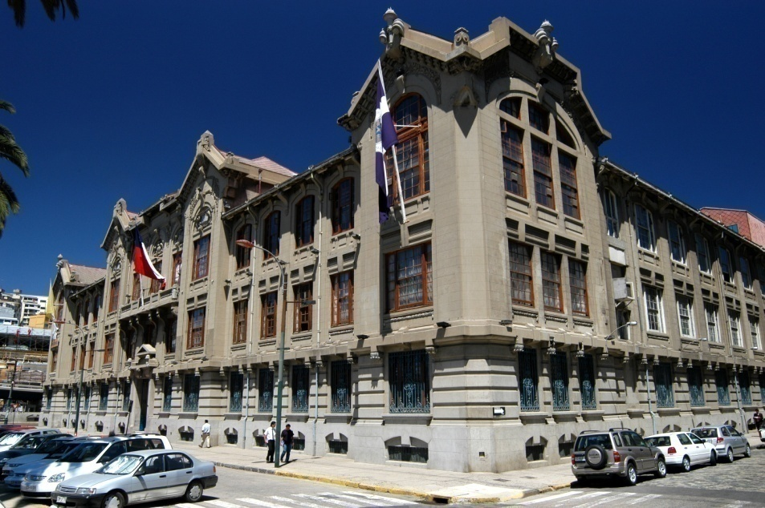

Slide 2
APEC-Tsukuba International Conference VII
Innovation of Mathematics Teaching and Learning through Lesson Study
February 2013
What is lesson study: a Chilean perspective arturo.mena@ucv.cl

Slide 4
About Chile

Slide 5
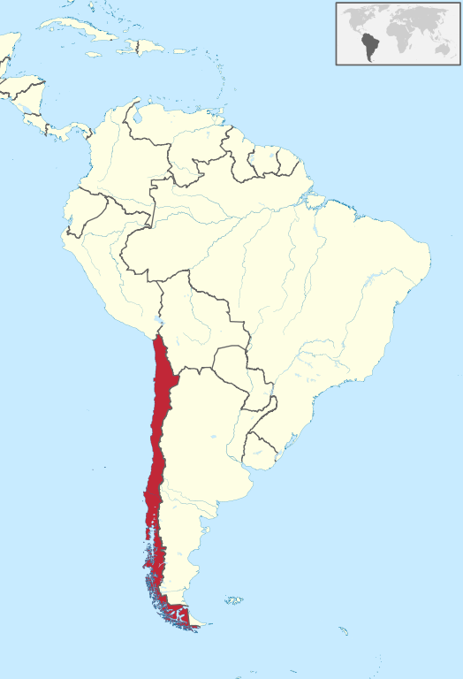

Slide 21
Japan-Chile agreement on Mathematics Education

Slide 28
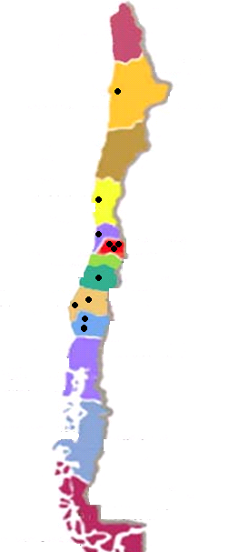

Slide 32
What the institutions did

Slide 50
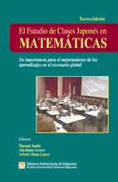

Slide 51
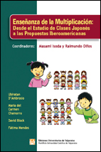

Slide 52
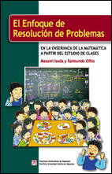

Slide 53
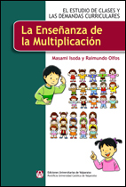

Slide 54
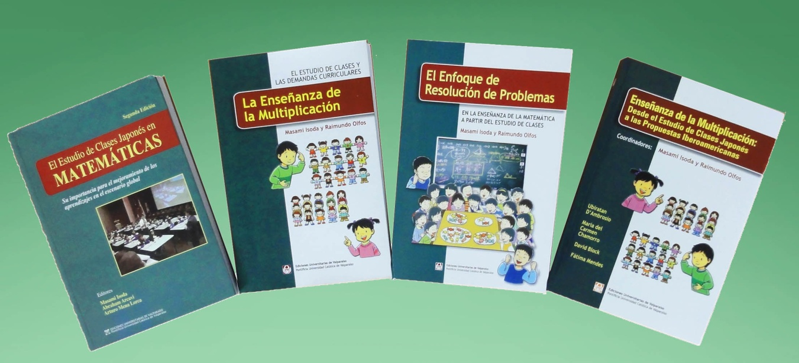
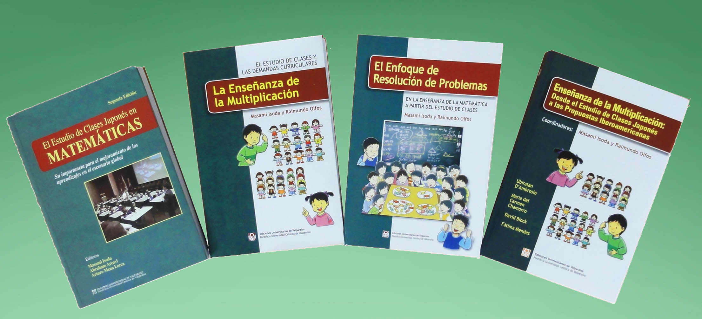

Slide 66
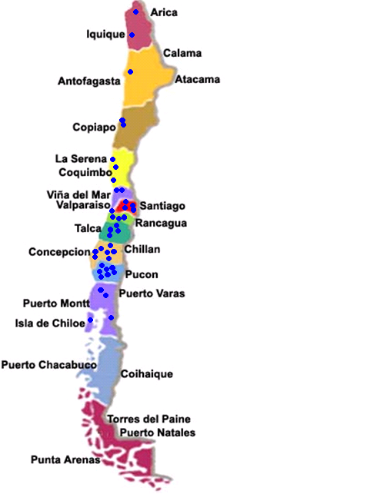
.

Slide 67
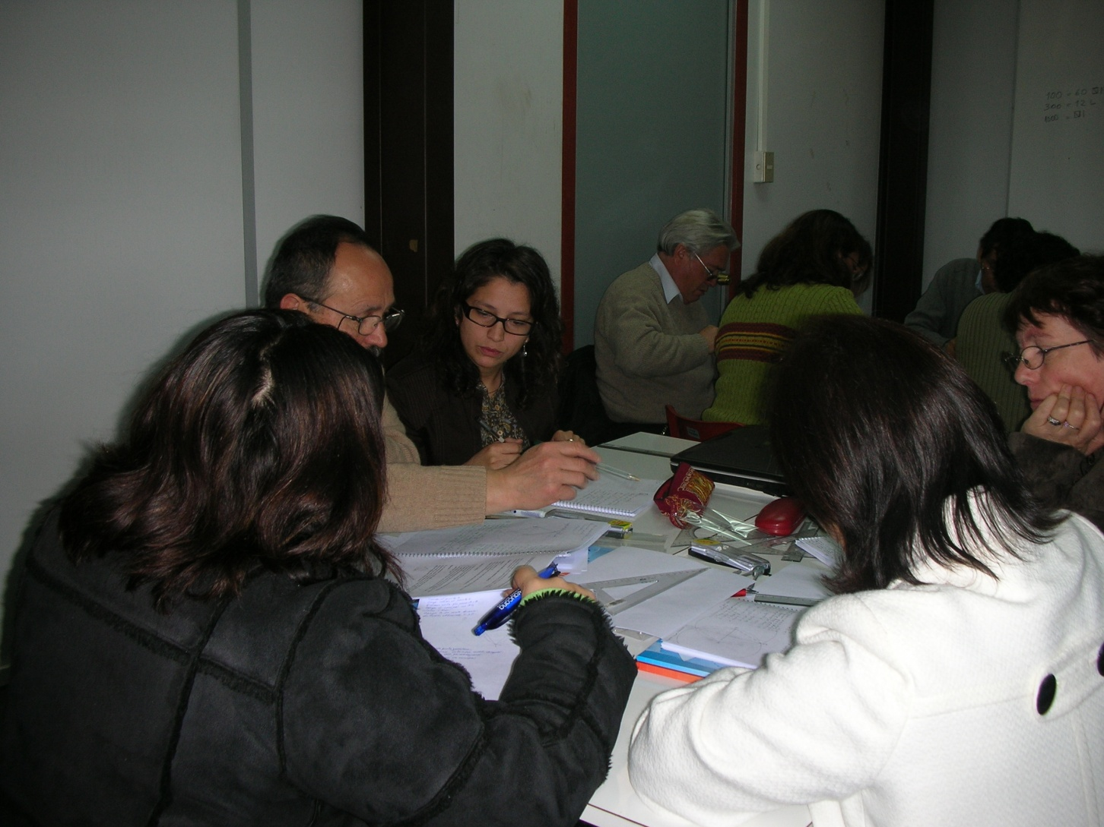

Slide 68
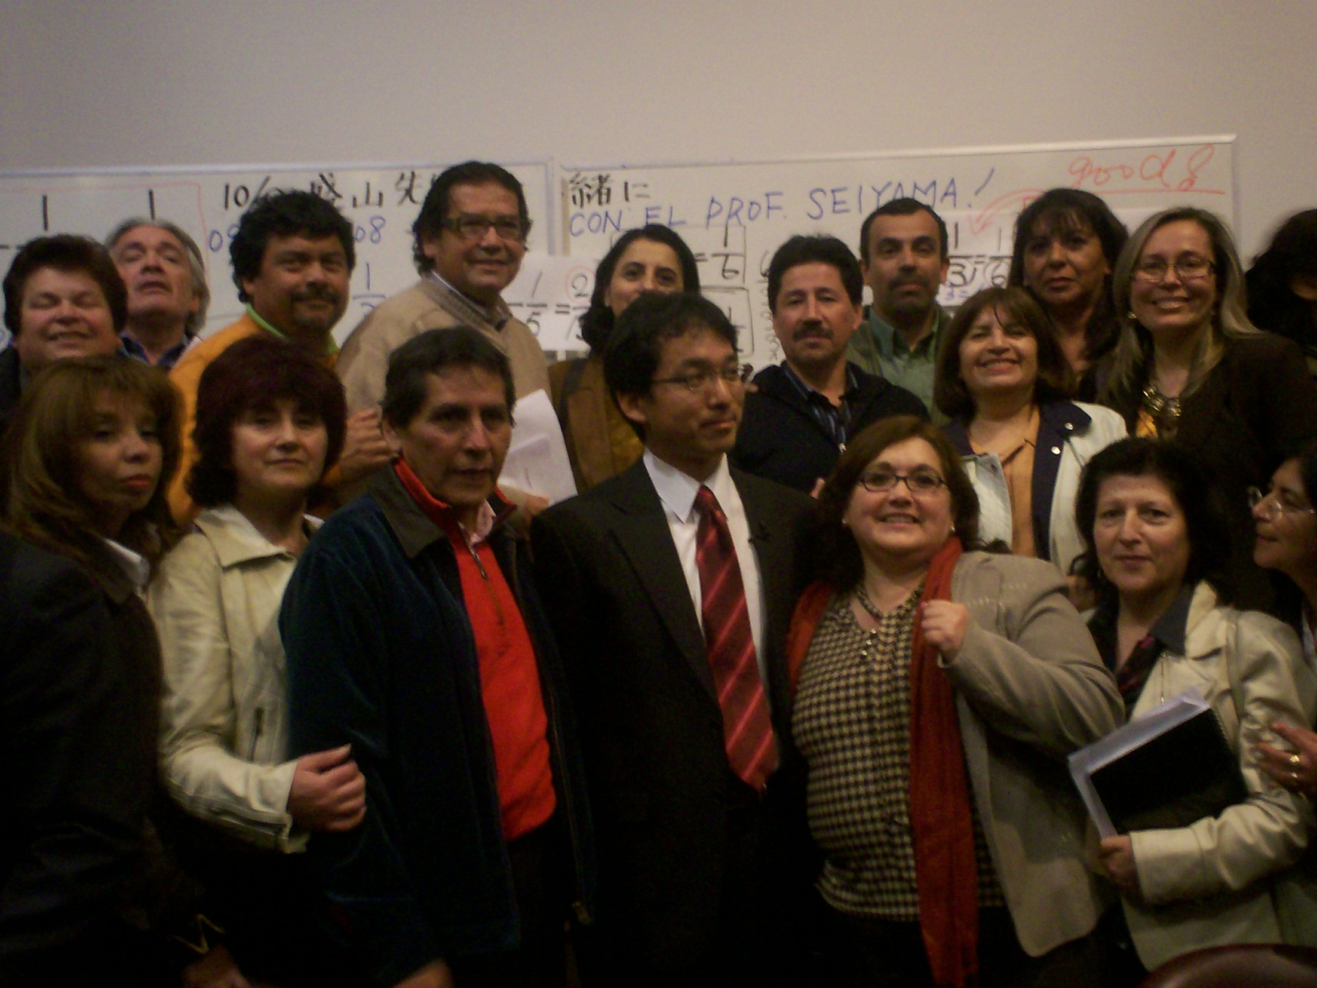

Slide 70
What now

Slide 73
Why Lesson Study is important in Chile

Slide 78
(What is Lesson Study: a Chilean approach)

Slide 79


Slide 89
Our understanding

Slide 94
Acknowledgement

Slide 102
どうもありがとうございました

